Slide 1
State of TerriaJS
Nick Forbes-Smith | FOSS4G 2022 Firenze

Slide 2
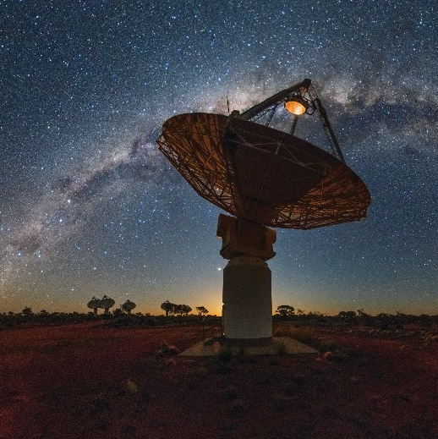

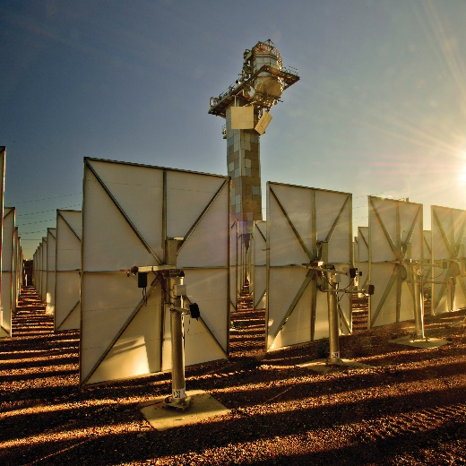
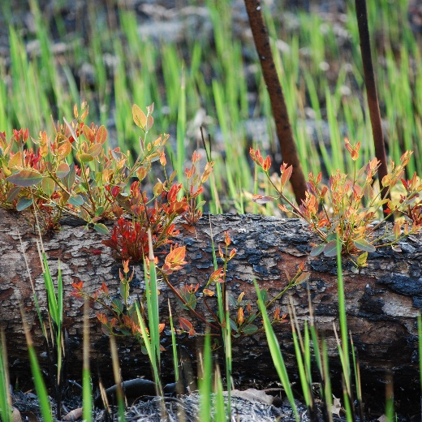
Who we are Australia’s national science agency
One of the world’s largest multidisciplinary science and technology organisations
5,200+ dedicated people working across 58 sites globally
State-of-the-art national research infrastructure
We delivered $7.6 billion of benefit to the nation in FY21
Notes:
Source: Page 6 of CSIRO’s Annual Report 2020-21

Slide 3
TerriaJS
An open-source framework for web-based geospatial catalogue explorers
Cesium/Leaflet based in-browser tool for looking at 2D and 3D data
Australian team working at CSIRO's Data61
Find us at terria.io

Slide 4
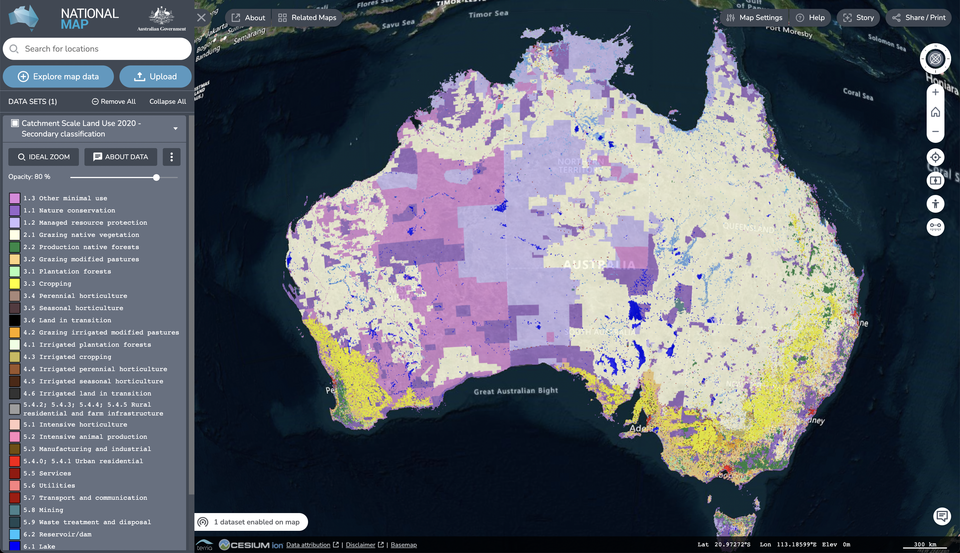
(Australian) NationalMap
nationalmap.gov.au
Birth of TerriaJS
Geospatial data discovery, visualisation and sharing
Launched 2014
14,000+ datasets, 30,000+ sessions/month

Slide 5
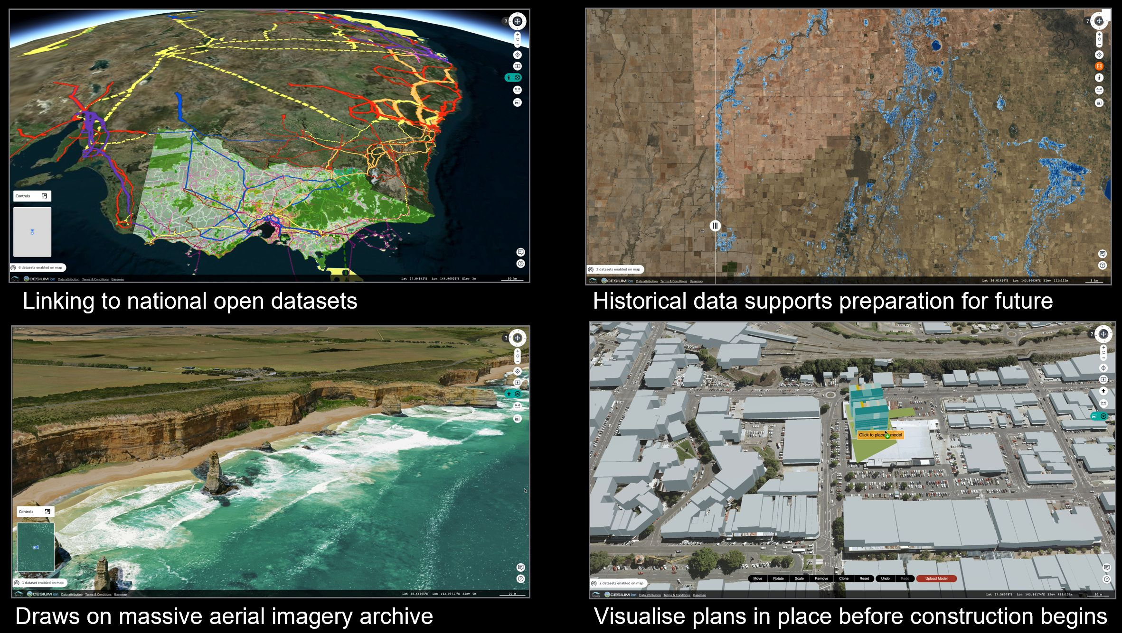
Victoria (Aus) Digital Twin
vic.digitaltwin.terria.io

Slide 6






















TerriaJS Adoption by Community
Industry
Gov/ Research
NGOs

Slide 7
Version 8 release
12 months ago
Big re-write to TypeScript / mobX
Becoming more stable
Thank you to all contributors
Especially to Zoran Kokeza!
Thanks for your patience

Slide 8
Some notable new features
Mapbox Vector Tile support using protomaps.js
Edit style (for vector data)
3D clipping box
3D splitter
New Plugin API - github.com/terriajs/plugin-sample
Translation – through Weblate

Slide 9
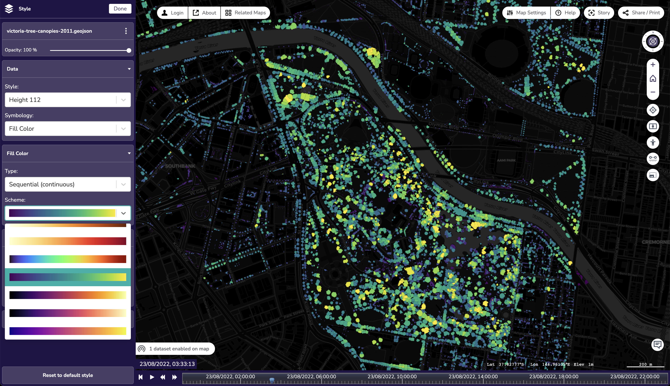
MVT + Edit style
vic.digitaltwin.terria.io

Slide 10
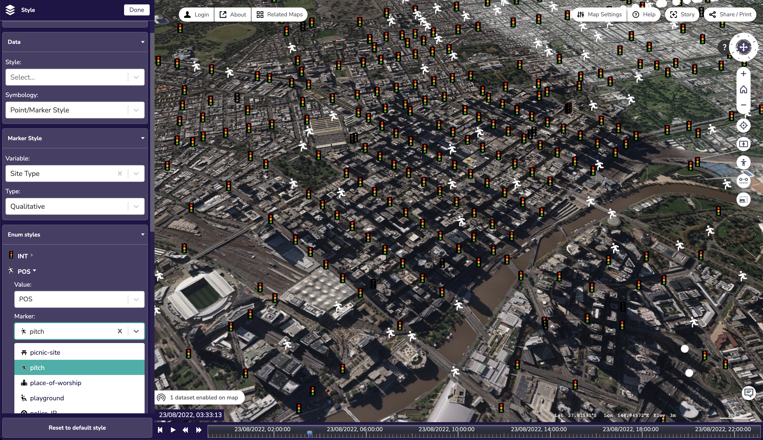
Edit style (marker)
vic.digitaltwin.terria.io

Slide 11
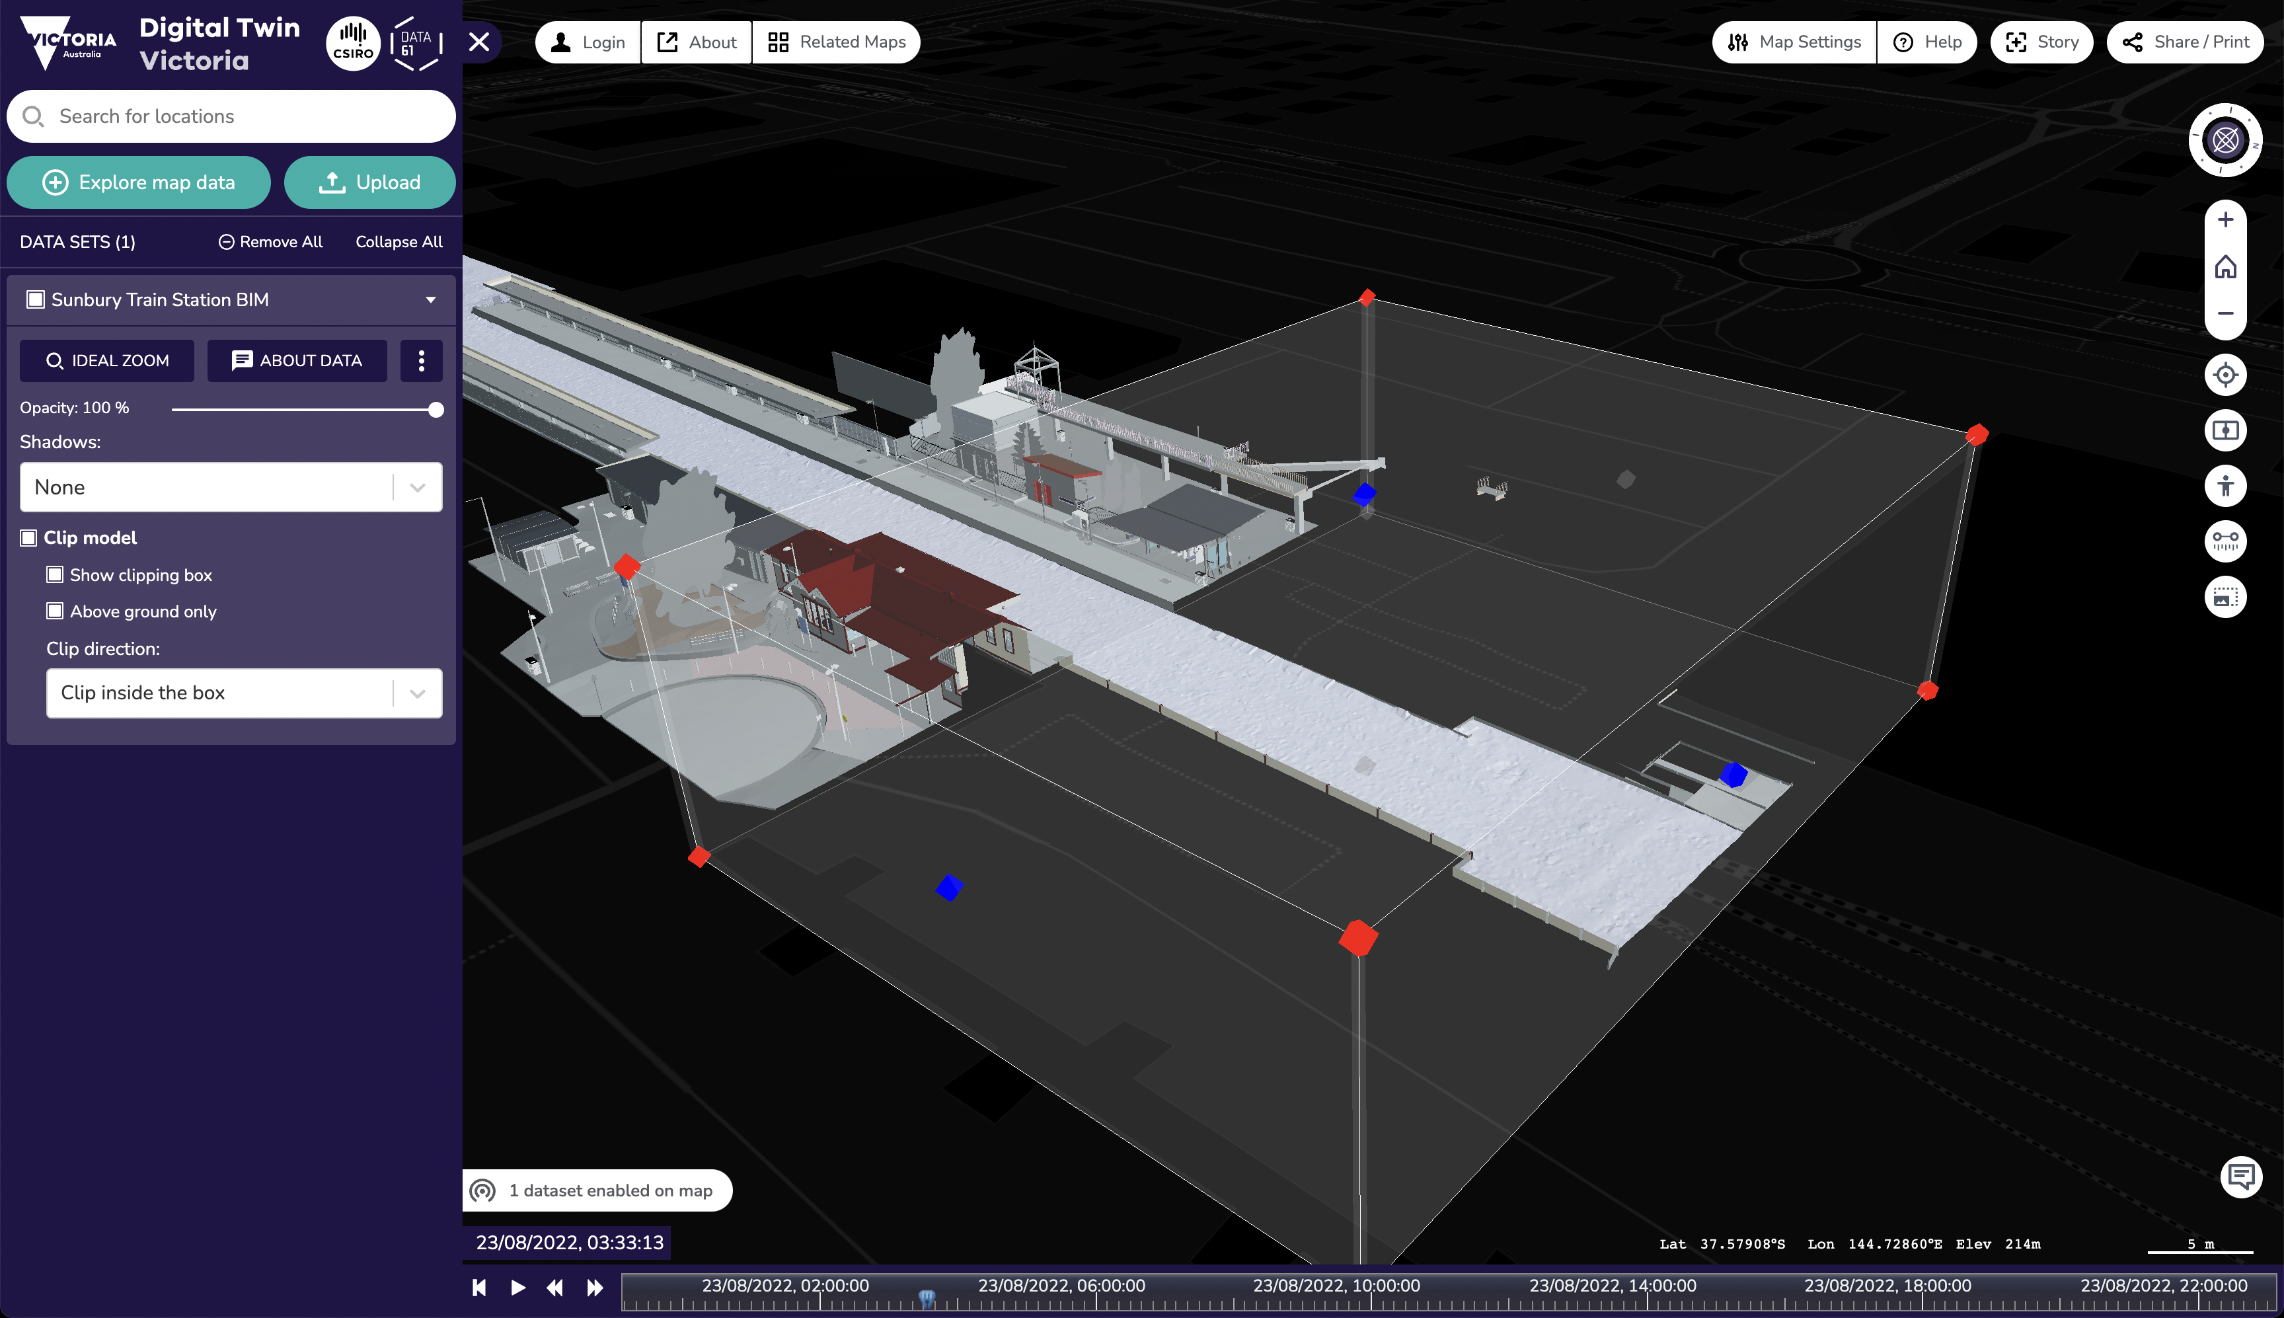
3D Clipping box
vic.digitaltwin.terria.io

Slide 12
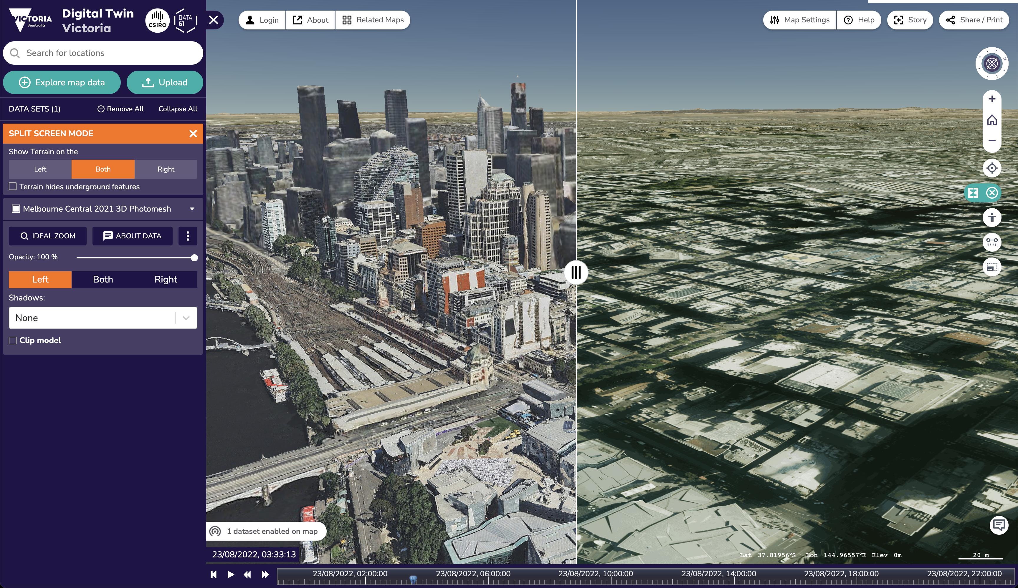
3D Splitter
vic.digitaltwin.terria.io

Slide 13
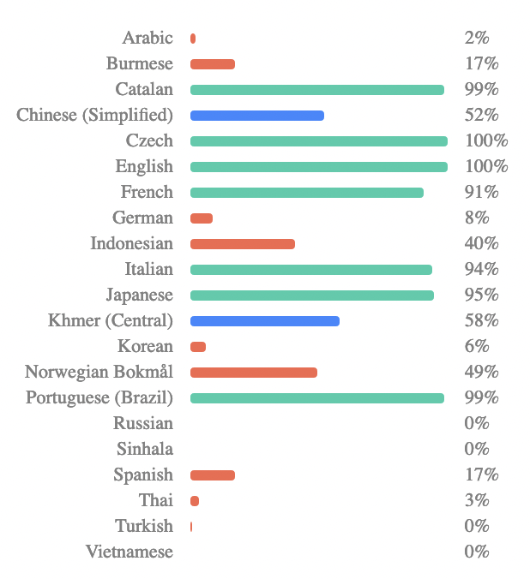
Translation
Thank you to contributors!

Slide 14
Future plans
Story v2.0
Compare/Splitter v2.0
Catalog search by location
UI / View layer refactor
Upgrade to TypeScript 4.x
Mobile support…
Improve documentation…

Slide 15
My other talk!
Exploring the World’s Open Data Portals
Discovery, Visualisation and Analysis of Open Data with TerriaJS
Friday 12:30–13:00 in Room 4
Links
terria.io
nationalmap.gov.au
vic.digitaltwin.terria.io
github.com/terriajs

